Slide 1

Week 12 Linear Algebra
By
Mr. Farhan Ali
farhan.ali@bnu.edu.pk
Beaconhouse National University, Lahore

Slide 2
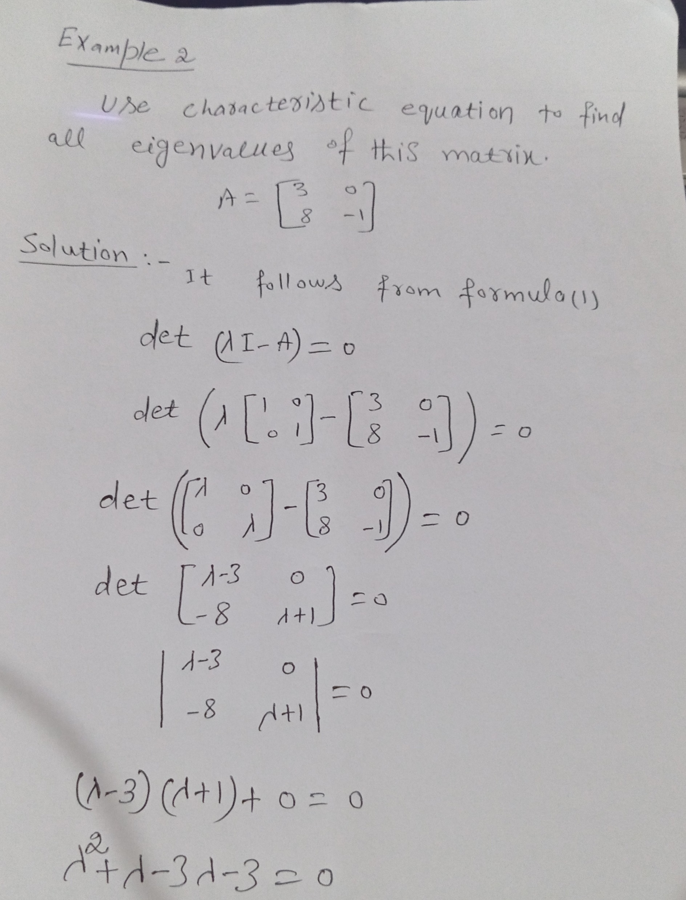

Slide 3
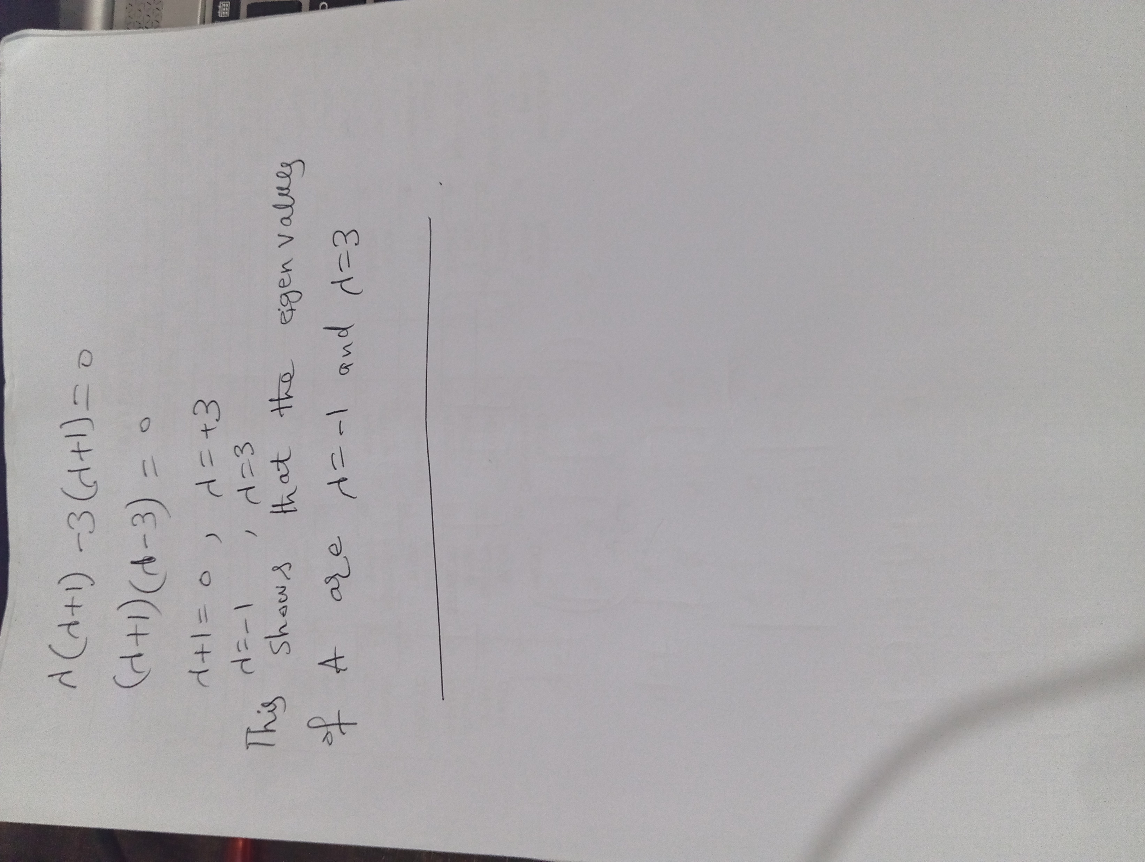

Slide 4
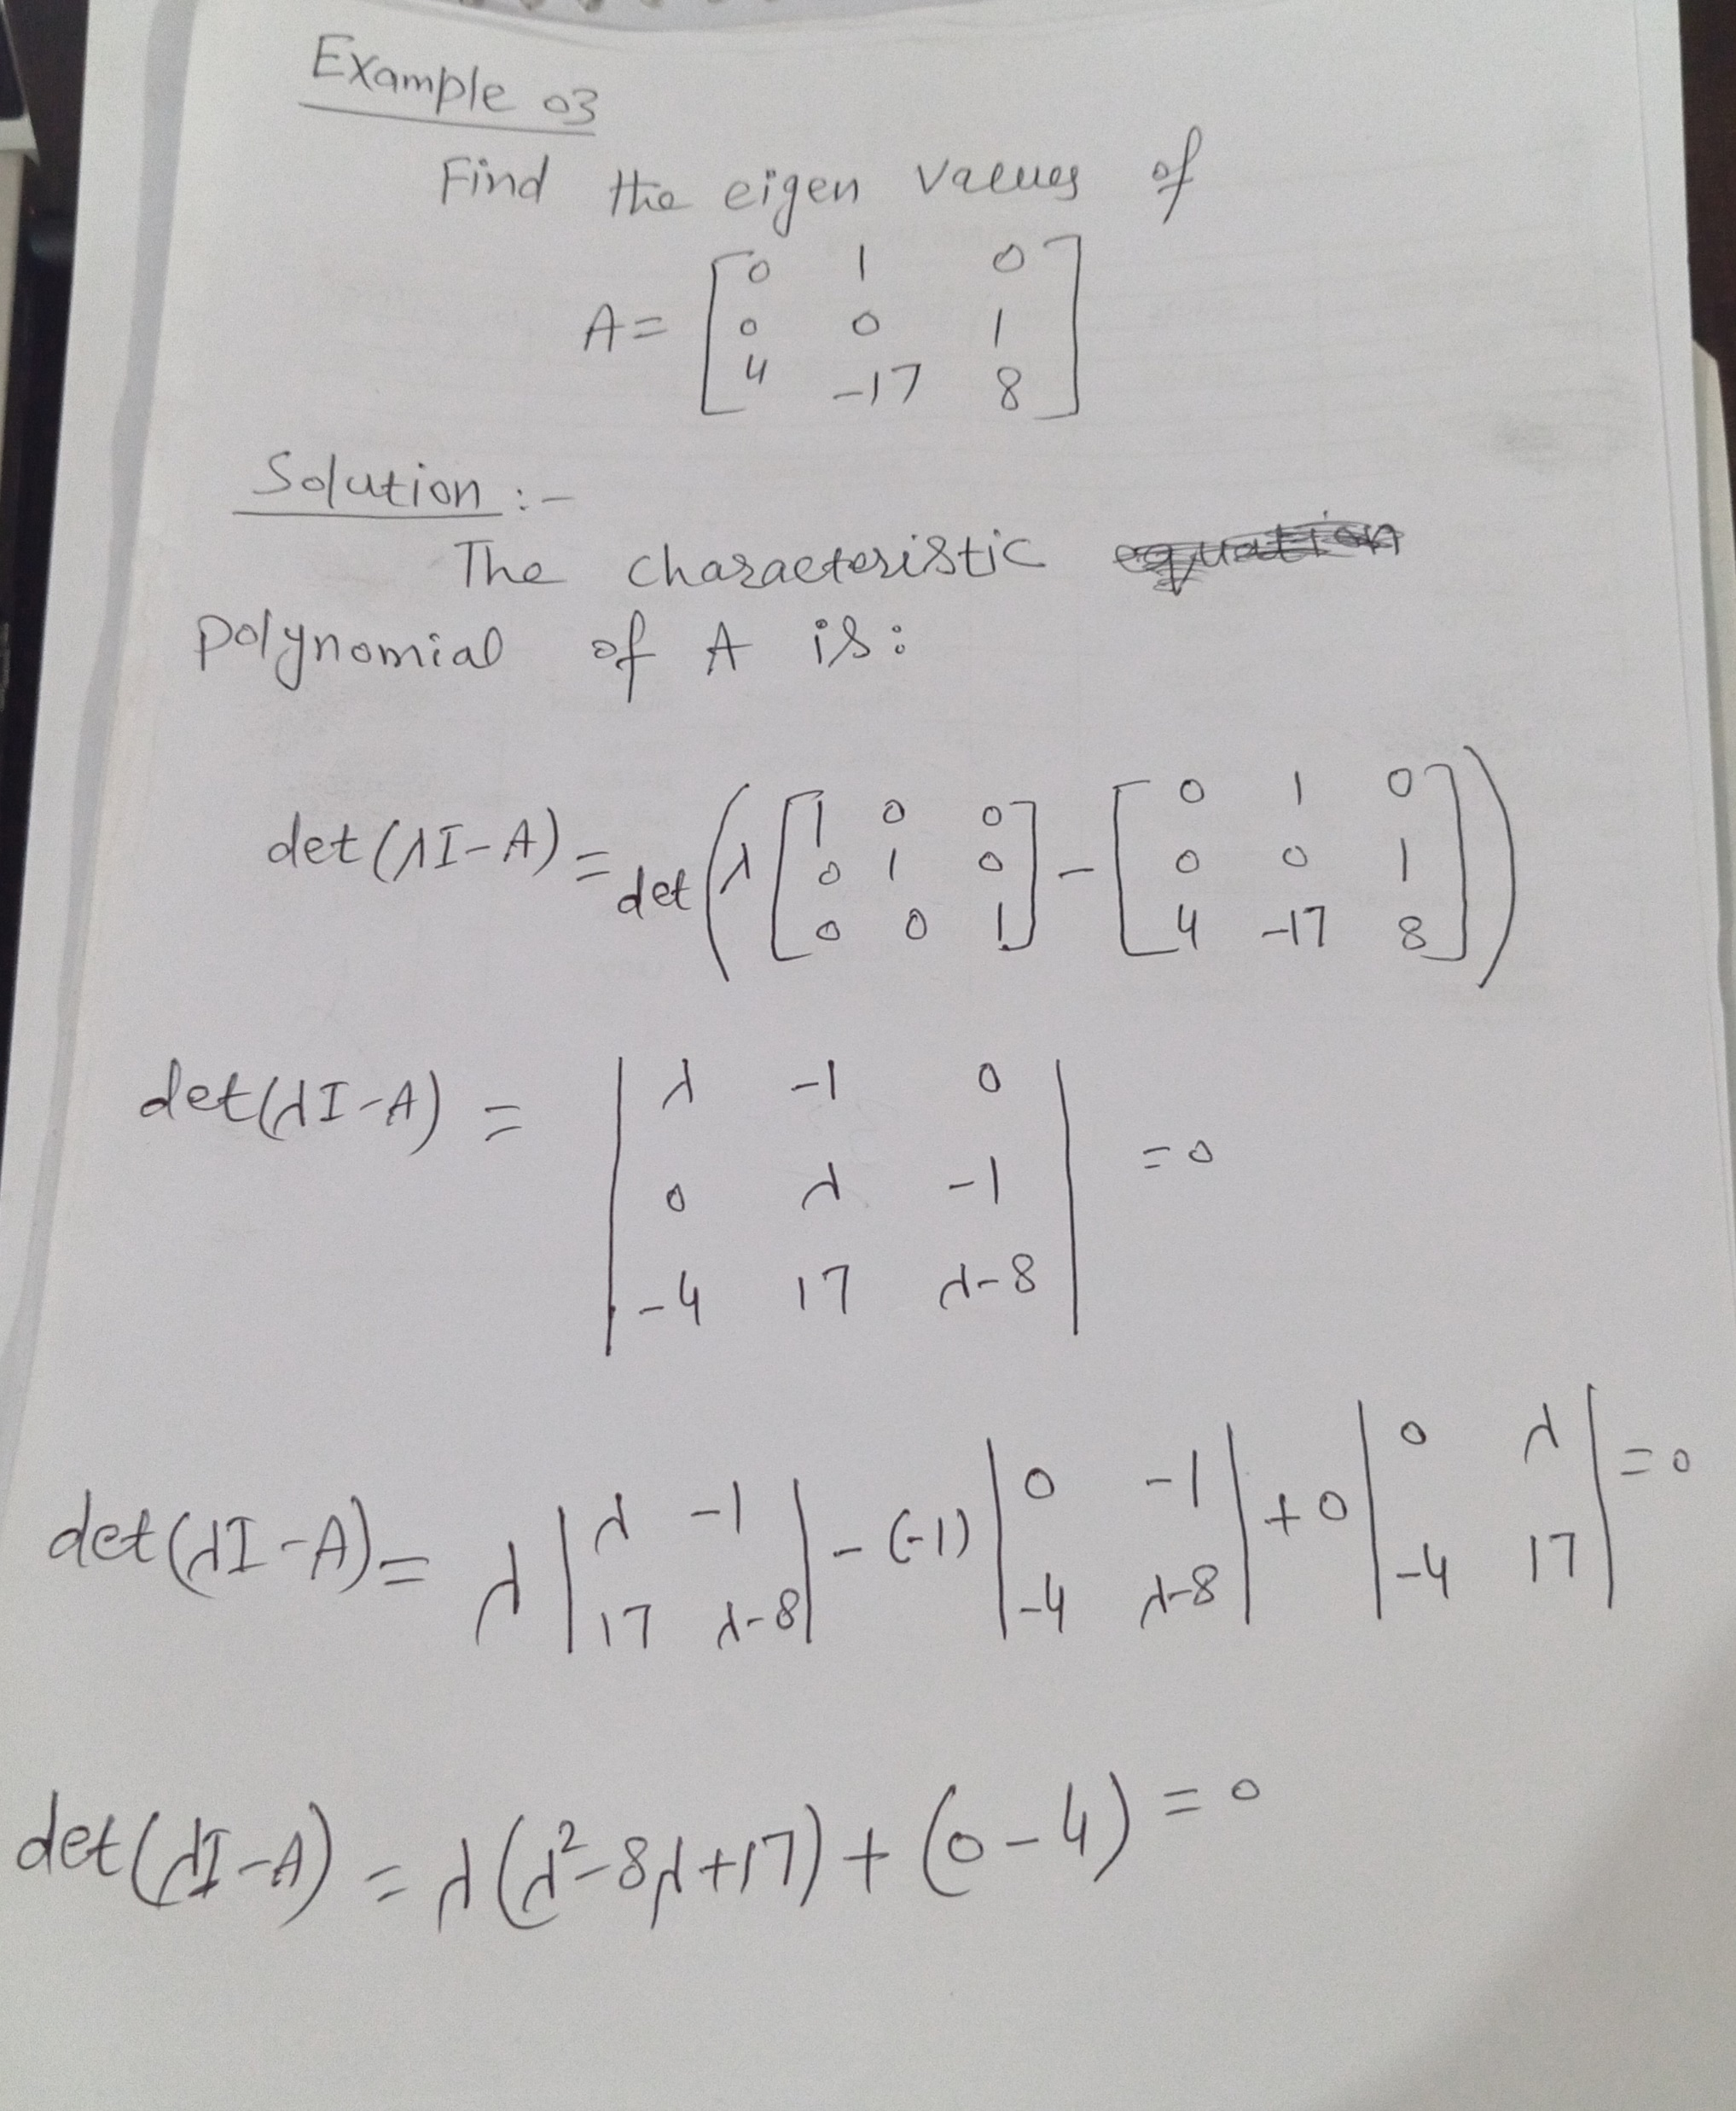

Slide 5
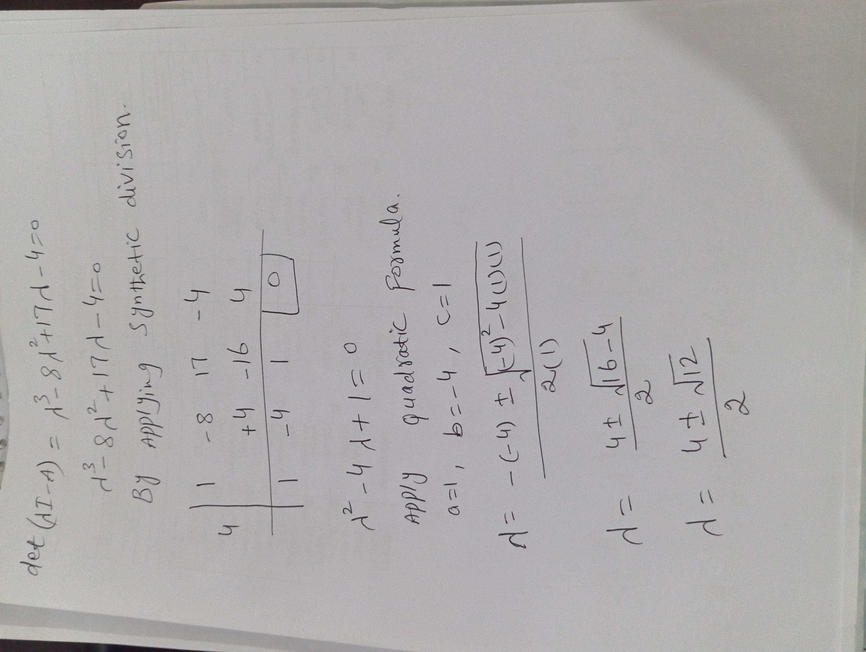

Slide 6
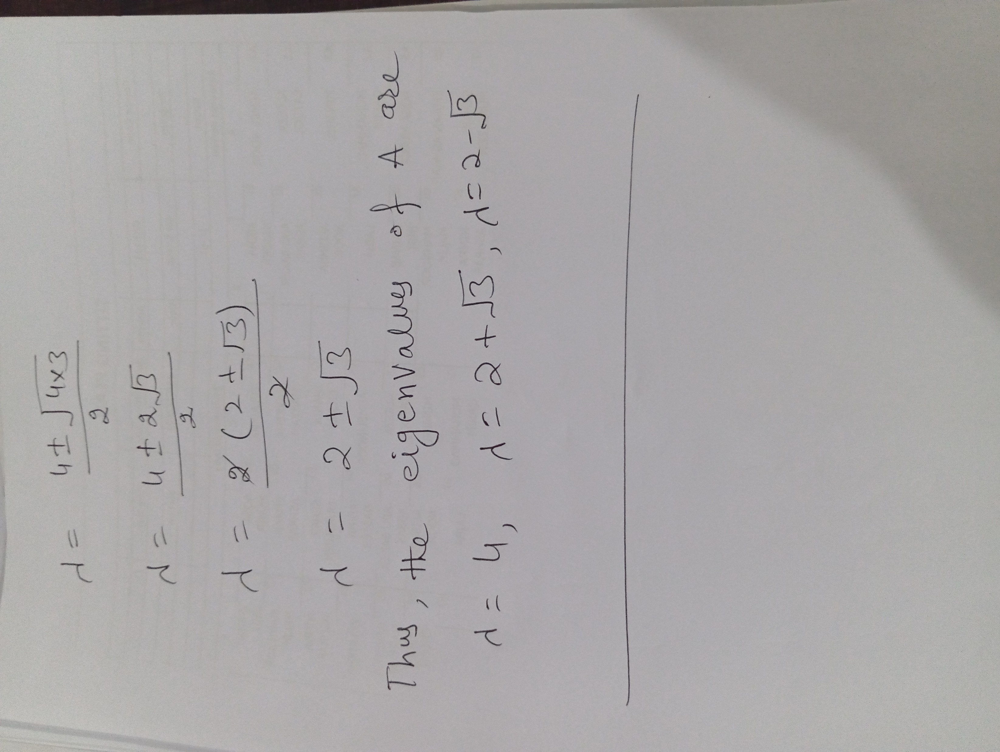

Slide 7
Thank You

